Slide 1
East Sussex Fire and Rescue Service Performance Report
Quarter 1 2023/24

Slide 2
Contents
  Report Overview 3
  Performance measures at a glance summary 4
  Service Priority Areas 8
  Performance Measures needing improvement 15
  Annual Performance Measures and new performance measures 24

Slide 3
Scrutiny and Audit Quarterly Performance Report
The aim of the Quarterly Performance Report is to summarise how East Sussex Fire & Rescue Service has performed over the previous quarter compared to previous year’s performance and to provide commentary in relation to the actions being taken to address performance.
The report contains the Service’s Strategic Measures (Tier 1) which are the high level outcome measures that provide a strong indication of organisational performance directly aligned to the delivery of the Purpose and Commitments. Targets are included and tolerances have been set to show a direction of travel against the measures which enables clearer performance reporting. Where indicators are new, tolerances and definitions will be set at a future date based on the annual result.
The explanations, mitigations and actions contained within this report are those endorsed by the Service Leadership Team (SLT). This report covers data from the period of 1 April 2023 – 30 June 2023.

Slide 4
Performance at a glance summary
At the end of Quarter 1 2023-24 the performance against 22 Strategic measures is as follows:
12 of the 22 measures had a GREEN status (55%)
8 were AMBER (36%)
2 were RED (9%)
Of the service priority areas
4 had a GREEN status, 2 had an AMBER status and 0 had a RED status.

Slide 5
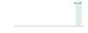

Performance at a glance
Performance Measures Achieving Target
92.91
PI_002 Percentage of Home
Safety Visits to vulnerable people
C 2 - ENGAGE WITH OUR COMMUNITIES
688
PI_004 Number of AFAs
C 1 - DELIVERING HIGH PERFORMING SERVICES
2,458
PI_006 Number of Home Safety Visits
C 2 - ENGAGE WITH OUR COMMUNITIES
153
PI_007 Number of inspections of high-risk premises completed
C 1 - DELIVERING HIGH PERFORMING SERVICES
31
PI_013 Number of industrial and commercial fires C 1 - DELIVERING HIGH PERFORMING SERVICES
77.62
PI_014 Percentage of On-Station first responses within 10 minutes C 1 - DELIVERING HIGH PERFORMING SERVICES
75.05
PI_015 Percentage of On-Call first responses within 15 minutes C 1 - DELIVERING HIGH PERFORMING SERVICES
2
PI_020 Number of RIDDOR incidents
C 3 - HAVE A SAFE AND VALUED WORKFORCE
96.65
PI_035 Percentage of emergency calls answered within 10 seconds
C 1 - DELIVERING HIGH PERFORMING SERVICES
100
PI_040 Percentage of Very High SSRIs that are in date
C 1 - DELIVERING HIGH PERFORMING SERVICES
1.69
PI_022 % of AFA calls to properties covered by RRO that become primary fires
C 1 - DELIVERING HIGH PERFORMING SERVICES
01:23
PI_036 Time between control receiving a 999 call and an appliance being mobilised
C 1 - DELIVERING HIGH PERFORMING SERVICES

Slide 6
Performance at a glance
Performance Measures Near Target
113
PI_001 Number of accidental dwelling fires
C 1 - DELIVERING HIGH PERFORMING SERVICES
2,521
PI_008 Number of incidents attended
C 1 - DELIVERING HIGH PERFORMING SERVICES
2.6
PI_003 Number of working days/shifts lost to sickness
C 3 - HAVE A SAFE AND VALUED WORKFORCE
261
PI_011 Number of primary fires
C 1 - DELIVERING HIGH PERFORMING SERVICES
88.29
PI_005 % of accidental dwelling fires confined to room of origin
C 1 - DELIVERING HIGH PERFORMING SERVICES
239
PI_016 Number of Fire safety checks completed
C 1 - DELIVERING HIGH PERFORMING SERVICES

Slide 7
Performance at a glance
Performance Measures Needing Improvement
4
PI_009 Number of deaths in primary fires
C 1 - DELIVERING HIGH PERFORMING SERVCIES
10
PI_010 Number of injuries in primary fires
C 1 - DELIVERING HIGH PERFORMING SERVICES
61
PI_021 Number of workplace reported accidents/injuries
C 3 - HAVE A SAFE AND VALUED WORKFORCE
211
PI_012 Number of deliberate fires
C 1 - DELIVERING HIGH PERFORMING SERVICES

Slide 8
Service Priority Areas
The Fire Authority priorities as agreed by the Scrutiny and Audit Panel are as follows:
Reducing accidental dwelling fires.
Undertake 9,000 home safety visits of which 90% to be delivered to vulnerable members of our community.
Reducing sickness.
Reducing attendance at false alarm calls.
Increasing inspections in high-risk premises.

Slide 9
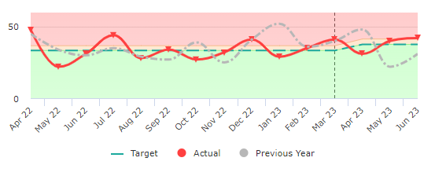
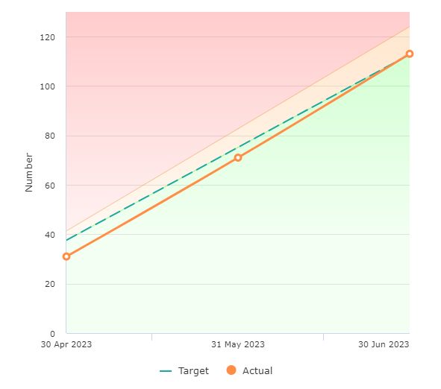
Priority 1 – Number of accidental dwelling fires
113 at end of Q1
RAG Status – Amber
The number of fires in dwellings where the cause of fire was accidental or not known
Reduction Target:
Green < 451
Amber 451- 496
Red > 496
Service Owner
Matt Lloyd
Area – Prevention and Protection (Community Safety)
Commentary and actions (Treat or Tolerate): Current Annual Projection – 453
Performance is within amber tolerance – so tolerate

Slide 10
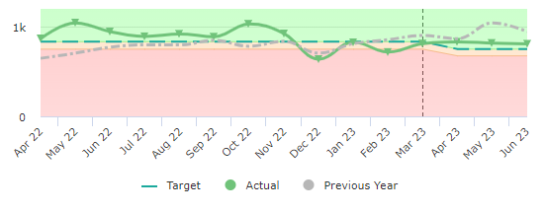
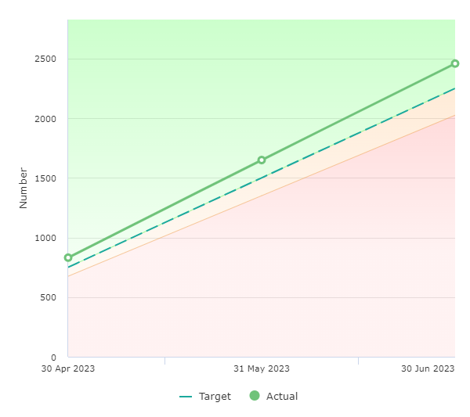
Priority 2a – Undertake 9,000 home safety visits
2,458 at end of Q1
RAG Status – Green
The number of home fire safety visits where the householder was given fire safety advice and or had a fire alarm installed.
Improvement Target:
Green > 9,000
Amber 8,100 - 9,000
Red < 8100
Service Owner
Matt Lloyd
Area – Prevention and Protection (Community Safety)
Commentary and actions (Treat or Tolerate): Current Annual Projection – 9,859
Performance is as expected and on track

Slide 11
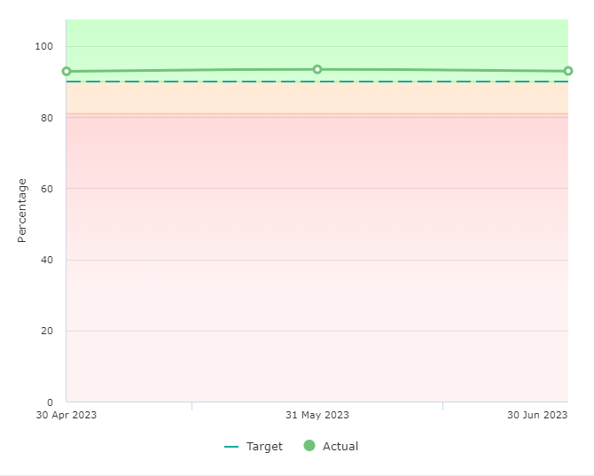
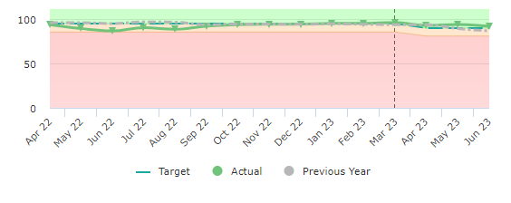
Priority 2b – Deliver 90% of all home safety visits to vulnerable members of our community.
92.9% at end of Q1
RAG Status – Green
Vulnerability is defined as lone pensioners, people over 65, people in rented accommodation, single parent families, hearing /sight impaired and those with a limiting long elderly.
Improvement Target:
Green > 90%
Amber 81% - 90%
Red < 81%
Service Owner
Matt Lloyd
Area – Prevention and Protection (Community Safety)
Commentary and actions (Treat or Tolerate): Current Annual Projection – 92.9%
Performance is on track

Slide 12
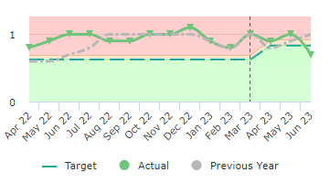
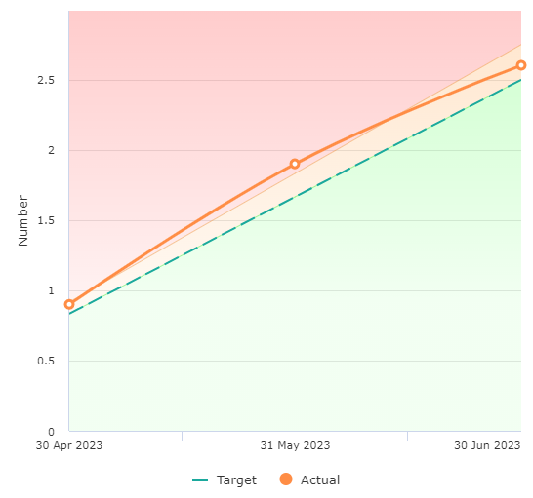
Priority 3 – Reducing the number of absences of our employees due to sickness
2.6 at end of Q1
RAG Status – Amber
The number of days/ shifts lost to sickness divided by the number of staff in post
Reduction Target:
Green < 10
Amber 10 -11
Red > 11
Service Owner
Jules King
Area – People Strategy
Commentary and actions (Treat or Tolerate): Current Annual Projection – 10.4
This continues to be a focussed area of work with the number of days lost to sickness being high. Some very complex cases are being monitored through the complex case review that is supported by managers, HR and Occupation Health. All cases where sickness have gone over 50 days have a specific plan and working with Occupational Health working to get staff back to work as soon as possible. The trial scheme for Benenden health care is due to start on 1 November 2023 and it is anticipated that those awaiting operations on the NHS will be able to access much quicker treatment.

Slide 13
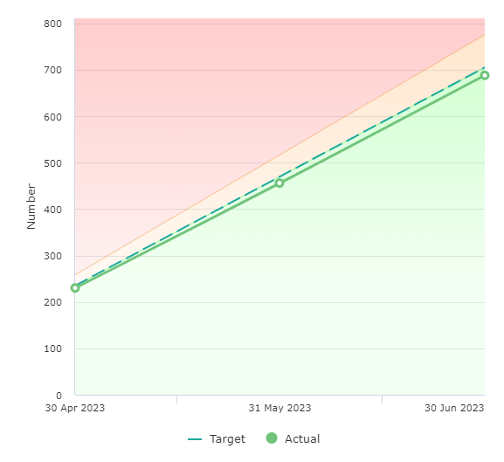
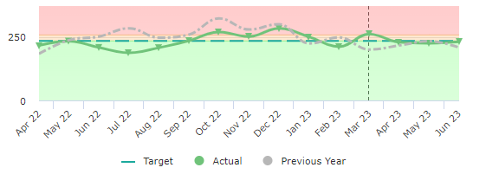
Priority 4 – Reducing attendance at automatic false alarms
688 at end of Q1
RAG Status – Green
Number of automatic fire alarms incidents attended to properties covered by the Fire Safety Order
Reduction Target:
Green < 2,820
Amber 2,820 - 3,102
Red > 3,102
Service Owner
Matt Lloyd
Area – Service Delivery (Business Safety)
Commentary and actions (Treat or Tolerate): Current Annual Projection – 2,760
Performance is on track

Slide 14
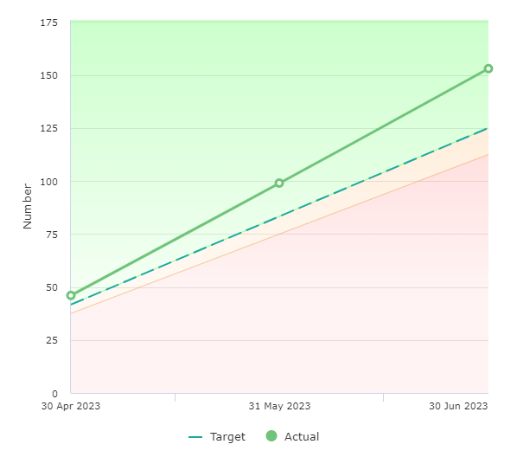
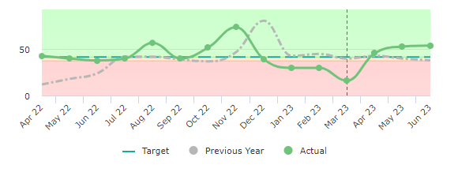
Priority 5 – Inspections of high-risk premises completed
153 at end of Q1
RAG Status – Green
The number of audits / inspections completed within East Sussex as provided from the reinspection list
Improvement Target:
Green > 500
Amber 450 - 500
Red < 450
Service Owner
Matt Lloyd
Area – Service Delivery (Business Safety)
Commentary and actions (Treat or Tolerate): Current Annual Projection – 614
Performance is on track

Slide 15
Performance measures needing improvement

Slide 16
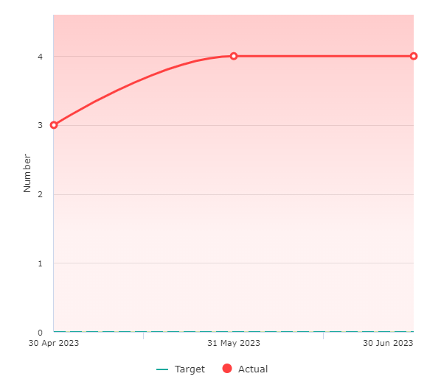
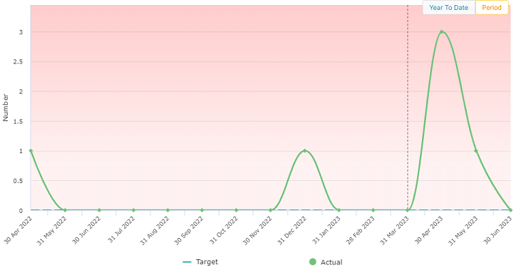
PI 09 – Number of primary fire deaths
4 at end of Q1
RAG Status – Red
The number of people whose death was caused by fire in a major fire which involves property, casualties or 5 or more appliances the death may occur weeks or months later.
Reduction Target:
Green < 0
Amber 1-3
Red > 3
Service Owner
Matt Lloyd
Area – Prevention & Protection (Community Safety)
Commentary and actions (Treat or Tolerate): Current Annual Projection – 6
This KPI has recently been reviewed and agreed that we strive to have no fire deaths within a year, therefore, any deaths will result in this KPI being red. The service undertakes fatal fire reviews after every fatal fire to determine any outcomes in respect of prevention activities.

Slide 17
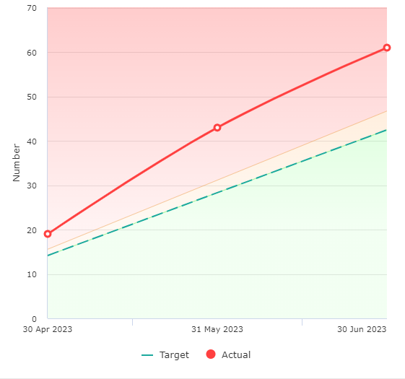
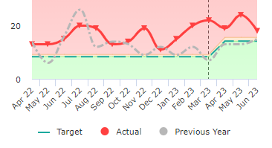
PI 21 – Number of workplaces reported accidents / injuries
61 at end of Q1
RAG Status – Red
The number of safety events received
Reduction Target:
Green < 170
Amber 170 – 187
Red > 187
Service Owner
Julie King
Area: Health, Safety and Wellbeing
Commentary and actions (Treat or Tolerate): Current Annual Projection – 244
There has been an increase in reported incidents in the first quarter of 2023/24. ESFRS has a positive reporting culture and encourage to report when accidents happen, however minor. This enables trends to be identified with specific action plans and focus to be identified. An area of focus is with vehicle accidents that when reported include all incidents such as where the drive was not at fault, low speed parking manoeuvres in tight spaces and wing mirrors clipping hedgerows.

Slide 18
Annual Performance Measures and new performance measures

