Slide 1
East Sussex Fire and Rescue Service Performance Report
Quarter 4 2023/24

Slide 2
Contents
  Report Overview 3
  Performance measures at a glance summary 4
  Service Priority Areas 9
  Performance Measures needing improvement 16
  Annual Performance Measures and new performance measures 22

Slide 3
Scrutiny and Audit Quarterly Performance Report
The aim of the Quarterly Performance Report is to summarise how East Sussex Fire & Rescue Service has performed over the previous quarter compared to previous year’s performance and to provide commentary in relation to the actions being taken to address performance.
The report contains the Service’s Strategic Measures (Tier 1) which are the high-level outcome measures that provide a strong indication of organisational performance directly aligned to the delivery of the Purpose and Commitments. Targets are included and tolerances have been set to show a direction of travel against the measures which enables clearer performance reporting. Where indicators are new, tolerances and definitions will be set at a future date based on the annual result.
The explanations, mitigations and actions contained within this report are those endorsed by the Service Leadership Team (SLT). This report covers data from the period of 1 April 2023 – 31 March 2024.

Slide 4
Performance at a glance summary
At the end of 2023-24 the performance against 23 Strategic measures is as follows:
13 of the 22 measures had a GREEN status (59%)
4 were AMBER (18%)
5 were RED (23%)
Of the service priority areas
4 had a GREEN status and 2 had a RED status.

Slide 5


Performance at a glance
Performance Measures Achieving Target
434
29
1,011
667
PI_001 Number of accidental dwelling fires
PI_010 Number of injuries in primary fires
PI_011 Number of primary fires
PI_012 Number of deliberate fires
C 1 - DELIVERING HIGH PERFORMING SERVICES
C 1 - DELIVERING HIGH PERFORMING SERVICES
C 1 - DELIVERING HIGH PERFORMING SERVICES
C 1 - DELIVERING HIGH PERFORMING SERVICES
118
78.13
75.22
1.27
PI_013 Number of industrial and commercial fires
PI_014 Percentage of On-Station first responses within 10 minutes
PI_015 Percentage of On-Call first responses within 15 minutes
PI_022 % of AFA calls to properties covered by RRO that become Primary fires
C 1 - DELIVERING HIGH PERFORMING SERVICES
C 1 - DELIVERING HIGH PERFORMING SERVICES
C 1 - DELIVERING HIGH PERFORMING SERVICES
C 1 - DELIVERING HIGH PERFORMING SERVICES
524
97.4
01:26
9,075
PI_007 Number of inspections of high-risk premises completed
PI_035 Percentage of emergency calls answered within 10 seconds
PI_036 Time between control receiving a 999 call and an appliance being mobilised
C 2 - ENGAGE WITH OUR COMMUNITIES
C 1 - DELIVERING HIGH PERFORMING SERVICES
C 1 - DELIVERING HIGH PERFORMING SERVICES
C 2 - ENGAGE WITH OUR COMMUNITIES

Slide 6
Performance at a glance
91.24
PI_002 Percentage of Home Safety Visits to vulnerable people
C 2 - ENGAGE WITH OUR COMMUNITIES

Slide 7
Performance at a glance
Performance Measures Near Target
88.94
10,562
185
PI_005 % of accidental dwelling fires confined to room of origin
PI_008 Number of incidents attended
PI_021 Number of workplace reported accidents/injuries
C 1 - DELIVERING HIGH PERFORMING SERVICES
C 1 - DELIVERING HIGH PERFORMING SERVICES
C 3 - HAVE A SAFE AND VALUED WORKFORCE
92.99
PI_044 % of Domestic Dwelling respondents satisfied with overall service from ESFRS
C 2 – ENGAGE WITH OUR COMMUNITIES

Slide 8

Performance at a glance
Performance Measures Needing Improvement
3,197
6
858
PI_009 Number of deaths in primary fires
PI_016 Number of Fire safety checks completed
PI_004 Number of AFAs
C 1 - DELIVERING HIGH PERFORMING SERVICES
C 1 - DELIVERING HIGH PERFORMING SERVICES
C 2 - ENGAGE WITH OUR COMMUNITIES
11.5
14
PI_003 Number of working days/shifts lost to sickness
PI_020 Number of RIDDOR incidents
C 3 - HAVE A SAFE AND VALUED WORKFORCE
C 3 - HAVE A SAFE AND VALUED WORKFORCE

Slide 9
Service Priority Areas
The Fire Authority priorities as agreed by the Scrutiny and Audit Panel are as follows:
Reducing accidental dwelling fires.
Undertake 9,000 home safety visits of which 90% to be delivered to vulnerable members of our community.
Reducing sickness.
Reducing attendance at false alarm calls.
Increasing inspections in high-risk premises.

Slide 10
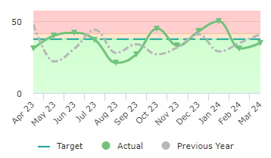
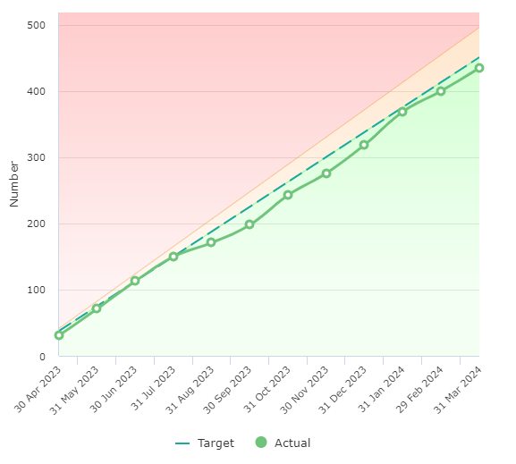
Priority 1 – Number of accidental dwelling fires
434 at end of Q4
RAG Status – Green
The number of fires in dwellings where the cause of fire was accidental or not known
Reduction Target:
Green < 451
Amber 451- 496
Red > 496
Service Owner
Matt Lloyd
Area – Prevention and Protection (Community Safety)
Commentary and actions (Treat or Tolerate): Annual Total – 434
We saw a spike of accidental dwelling fires in the month of January. February and March returned to a more stable figure. The accidental fire dwelling group continue to monitor trends and adjust prevention communications to target. The ADF group is currently reviewing it’s Terms of Reference to ensure it is reflective of the service requirement. First quarter of this performance year has seen figures fall back into performance thresholds.

Slide 11
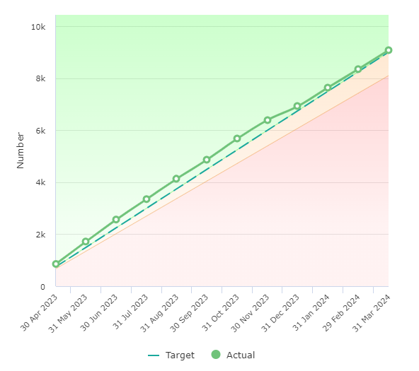
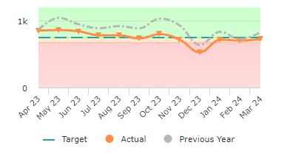
Priority 2a – Undertake 9,000 home safety visits
9,075 at end of Q4
RAG Status – Green
The number of home fire safety visits where the householder was given fire safety advice and or had a fire alarm installed.
Improvement Target:
Green > 9,000
Amber 8,100 - 9,000
Red < 8100
Service Owner
Matt Lloyd
Area – Prevention and Protection (Community Safety)
Commentary and actions (Treat or Tolerate): Annual Total – 9,075

Slide 12
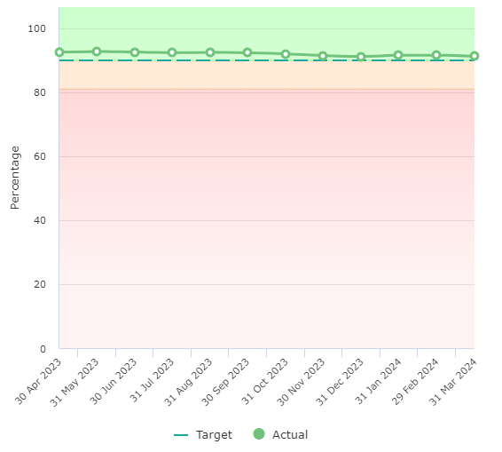
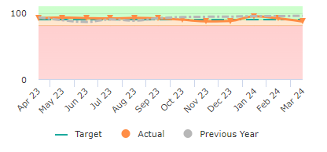
Priority 2b – Deliver 90% of all home safety visits to vulnerable members of our community.
91.2% at end of Q4
RAG Status – Green
Vulnerability is defined as lone pensioners, people over 65, people in rented accommodation, single parent families, hearing /sight impaired and those with a limiting long elderly.
Improvement Target:
Green > 90%
Amber 81% - 90%
Red < 81%
Service Owner
Matt Lloyd
Area – Prevention and Protection (Community Safety)
Commentary and actions (Treat or Tolerate): Annual Total – 91.2%

Slide 13
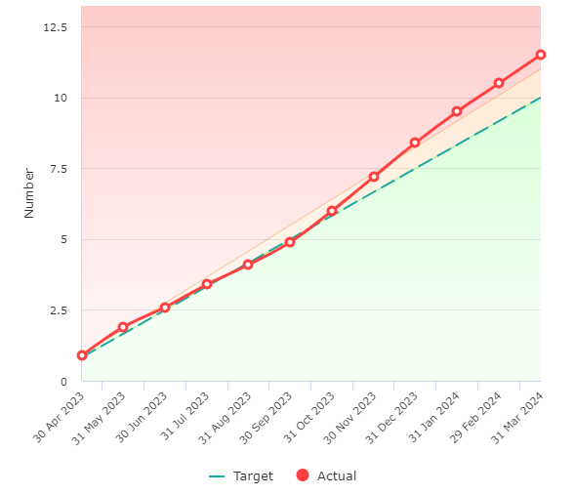
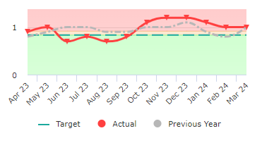
Priority 3 – Reducing the number of absences of our employees due to sickness
11.5 at end of Q4
RAG Status – Red
The number of days/ shifts lost to sickness divided by the number of staff in post
Reduction Target:
Green < 10
Amber 10 -11
Red > 11
Service Owner
Jules King
Area – People Strategy
Commentary and actions (Treat or Tolerate): Annual Total – 11.5
The increase in sickness through quarter three which was as a result of seasonable short-term absences such as colds and sore throats and whilst the quarter four performance is slightly improved, these two quarters have resulted in an overall picture of 11.5 shifts lost per person. Local managers, HR colleagues and Occupational Health continue to support and manage the long-term cases and there has been a recent return of some staff from long term sickness, unfortunately we continue to see more complex long term sickness cases as a result of mental health and musculoskeletal injury. Local managers continue to work with staff through engagement with the bradford scoring tool ensuring those who are recording higher levels of sickness are engaged with and supported appropriately.
People Services will be undertaking a contract analysis of all resources contracted in via the OH Collaboration such as physio, counselling, etc. This is to ensure that clear SLAs are defined and being adhered to.
Staff membership of Benenden health is currently 140 with 35 interactions and benefits received to date; including 3 orthopaedic surgeries, 2 general surgeries, 2 ENT and 2 rheumatology, which will support staff returning to work sooner than if they remained within the NHS.

Slide 14
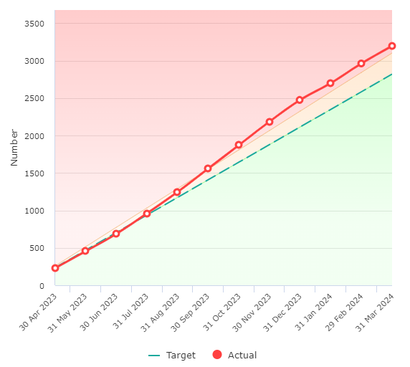
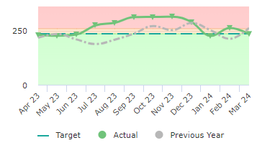
Priority 4 – Reducing attendance at automatic false alarms
3,197 at end of Q4
RAG Status – Red
Number of automatic fire alarms incidents attended to properties covered by the Fire Safety Order
Reduction Target:
Green < 2,820
Amber 2,820 - 3,102
Red > 3,102
Service Owner - Matt Lloyd /George O’Reilly
Area – Response & Protection
Commentary and actions (Treat or Tolerate): Annual Total – 3,197
As a result of the change in legislation and due to the increased interactions, we are carrying out with premises for FSC’s and Audits, more detection systems have been installed. This will inevitably increase the number of false alarms (NFCC guidance and statistics). On 1 April 2024 we have introduced that we will no longer be attending low risk commercial alarms (significant numbers) and through enforcement activity, if the premises owners do not correctly maintain these systems they may be prosecuted or dealt with through formal enforcement. Work continues with stations to target those premises that have repeat false alarm problems. A review will take place to see how this process could be enhanced.

Slide 15
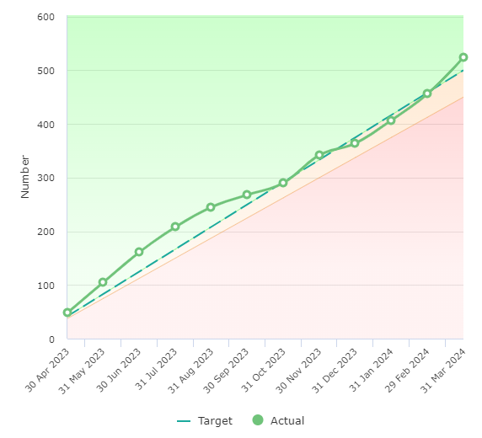
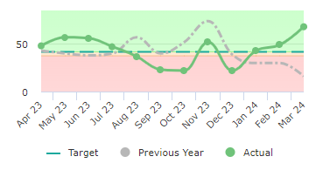
Priority 5 – Inspections of high-risk premises completed
524 at end of Q4
RAG Status – Green
The number of audits / inspections completed within East Sussex as provided from the reinspection list
Improvement Target:
Green > 500
Amber 450 - 500
Red < 450
Service Owner
Matt Lloyd
Area – Service Delivery (Business Safety)
Commentary and actions (Treat or Tolerate): Annual Total – 524

Slide 16
Performance measures needing improvement

Slide 17
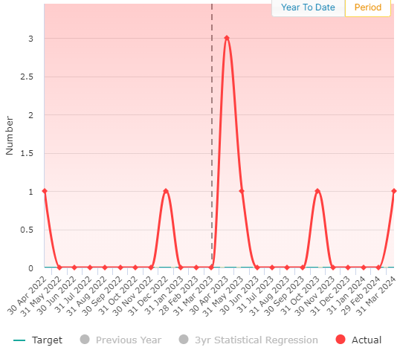
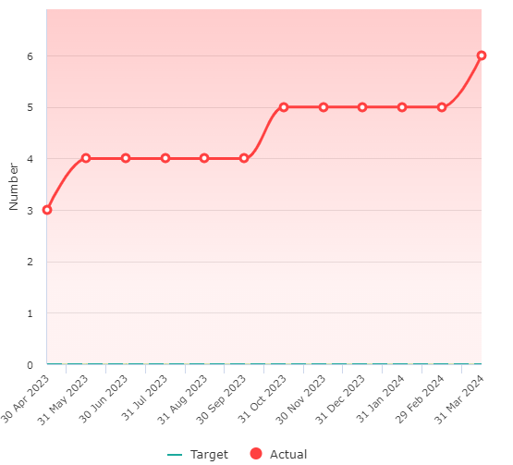
PI 09 – Number of primary fire deaths
6 at end of Q4
RAG Status – Red
The number of people whose death was caused by fire in a major fire which involves property, casualties or 5 or more appliances the death may occur weeks or months later.
Reduction Target:
Green = 0
Amber > 0-3
Red > 3
Service Owner
Matt Lloyd
Area – Prevention & Protection (Community Safety)
Commentary and actions (Treat or Tolerate): Annual Total – 6
This KPI has recently been reviewed and agreed that we strive to have no fire deaths within a year, therefore, any deaths will result in this KPI being red. The service undertakes fatal fire reviews after every fatal fire to determine any outcomes in respect of prevention activities. Q4 fatality is currently being investigated by the police so the outcome of this fatality will be updated pending this investigation.

Slide 18
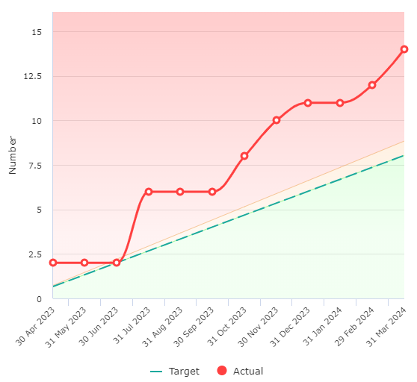
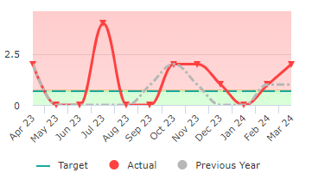
PI 20 – Number of RIDDOR incidents
14 at end of Q4
RAG Status – Red
The number of incidents required to be reported under the Reporting of Injuries, Diseases and Dangerous Occurrences Regulations 1995 that were reported to the Health & Safety section through the Service’s accident reporting procedure.
Reduction Target:
Green < 5
Amber 6
Red > 6
Service Owner
Julie King
Area: Health, Safety and Wellbeing
Commentary and actions (Treat or Tolerate): Annual Total – 14
The Service has seen a 75% increase in the number of RIDDOR reportable incidents this
year. The majority of RIDDORs reported this year were over 7 day injuries for manual
handling injuries. One was a member of the public taken directly to hospital, following
receiving an electric shock.

Slide 19
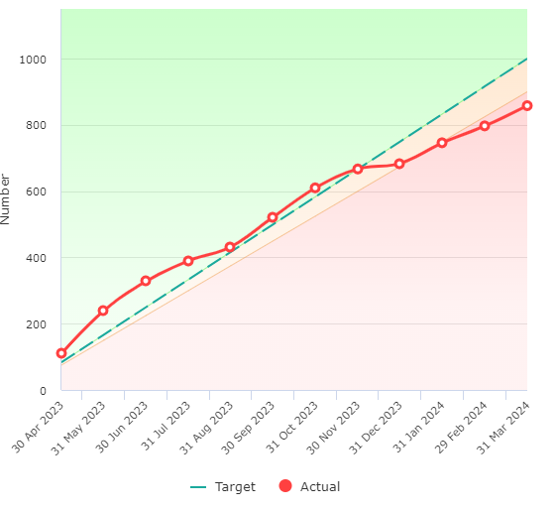
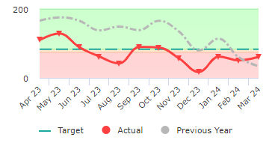
PI 16 – Number of Operational Business Safety Visits completed
858 at end of Q4
RAG Status – Red
Total number of Fire safety checks undertaken and completed by operational crew members and officers.
Improvement Target:
Green > 1,000
Amber 900 – 1,000
Red < 900
Service Owner
Matt Lloyd
Area: Prevention and Protection (Protection)
Commentary and actions (Treat or Tolerate): Annual Total – 858
Due to the number of interactions through audits, complaints and fire safety checks resulting in non-compliance as well as the limited capacity of our legal team due to restricted numbers of fully-qualified and experienced staff. This has greatly impacted the capacity of our Protection Legal Team to deliver our legally required enforcement actions. As a result, there was a conscious decision to reduce the targets by 50% to reduce the impact on the protection departments legal team and to free time up for crews to carry out more training. Please note the 2022-2023 figure is higher due to the development programme for the Protection staff only allowing unqualified fire safety staff to carry out safety checks. As they have become more qualified in 2023-2024 they have progressed to carrying out audits rather than fire safety checks. New governance and monitoring linked to the risk reduction process is now in place providing further dynamic scrutiny and an action plan is in place.

Slide 20
Annual Performance Measures and new performance measures

