Slide 1
Exploring Zero Tolerance
We all want our colleagues to feel supported, safe and secure at work and the impact of unacceptable behaviour, whether bullying, harassment, assault or abuse, is hugely damaging.
"We have a zero-tolerance approach" is a phrase often used but what does this look like in reality?
This session aims to explore how we can work together.
Notes:
IMPORTANT - If you choose to record all or part of the session, you must make this clear before starting to record and explain clearly what will happen to the footage i.e. internal use for x months. Please recognise that this may affect the level of engagement you receive.
LEAD FACILITATOR
Explain the aims of the session:
To provide a safe space for conversation and questions
To capture key points which can be fed into other work
To help you all become more confident in talking about this with colleagues
Rules of engagement
Questions can be added to the chat during the session or you can put your hand up
Be supportive, listen to each other and allow space for people to sound out their thoughts and ideas
What happens now
We will run though some of the findings of the short survey about zero tolerance which we carried out ahead of this event.
MAIN SPEAKER will share their thoughts on taking a Prevention, Protection, Response approach to zero tolerance.

Slide 2
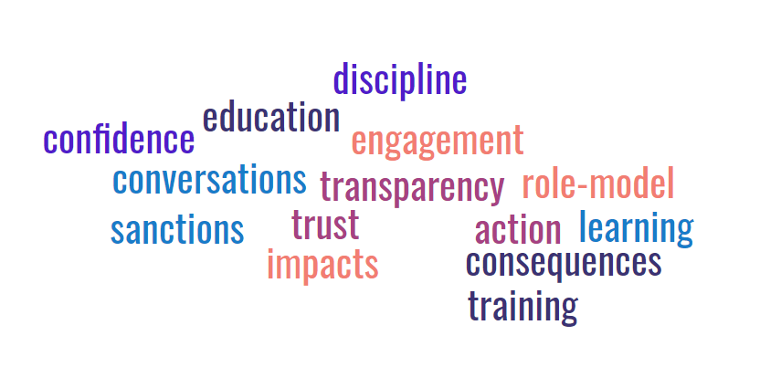
Understanding Zero Tolerance
The language you used…..
Notes:
Lead facilitator
We have circulated the findings of our very short and incredibly unscientific survey.
Recap the questions and run through results
What does Zero Tolerance mean to you?
How we can help stop unacceptable behaviour happening in the first place?
If unacceptable behaviour does happen, what action can be considered to stop things getting worse or happening again?
Hand over to Main Speaker

Slide 3
Prevention
Protection
Response
Notes:
Lead speaker
When considering values, behaviours and zero tolerance, it may be helpful to link it to the three areas we often speak about in this sector – prevention, protection and response.
Examples include:
Prevention – having the right policies and procedures, staff being aware of service values, encouraging positive engagement and improving communication skills
Protection – what support is in place for both those that are reporting and are facing allegations – consider the role of HR, have Occ Health been notified, do you understand the context to ensure an appropriate investigation
Response – making timely decisions, communicating these not only to those directly involved but wider without breaching confidentiality – we can't report case by case but what about an annual report on headline numbers, reporting to key stakeholders

Slide 4
Break out sessions
Prevention - what do staff need to know to prevent unacceptable behaviour? What barriers exist and what solutions are available to remove them?
Protection - what needs to be in place to support all involved? Who else needs to be protected during this?
Response - what does "good" look like? How do you ensure timely and fair decisions? What action can be considered to stop things getting worse or happening again?
Notes:
Lead facilitator
Time to talk…. we’d like you to think about the detail of HOW to support zero-tolerance!
There’s time for a quick 5 minute break, and on your return, you should be in your break-out room.
Your host will guide you through these questions.

Slide 5
Feedback and close
Prevention - what do staff need to know to prevent unacceptable behaviour? What barriers exist and what solutions are available to remove them?
Protection - what needs to be in place to support all involved? Who else needs to be protected during this?
Response - what does "good" look like? How do you ensure timely and fair decisions? What action can be considered to stop things getting worse or happening again?
Notes:
Lead facilitator to ask group facilitators for feedback.
Main speaker to offer thoughts.
Wrap up – explaining what will happen to the information gathered.
Close

